Slide 1


Finding a better place in Scarborough, Toronto

Slide 2
Data driven decision making while moving to a new place is beneficial for migrating people
The project intends to help people make smarter and informed decisions on selecting a great neighbourhood from the various other neighbourhoods in Scarborough, Toronto.
Foreigners are migrating to different regions of Canada and are in need of quality research to understand housing prices and school districts to make an informed decision of moving.

Slide 3
Data acquisition and cleaning
Scarborough dataset will be used which was scrapped from wikipedia for Week 3. Dataset consisting of latitude and longitude, zip codes.
Data about different venues in different neighbourhoods of that specific borough.To obtain that information we will use "Foursquare" locational information
Such information includes venue names, locations, menus and even photos. As such, the foursquare location platform will be used as the only data source since all the stated required information can be obtained through the API.

Slide 4
The data retrieved from Foursquare contained information of venues within a specified distance of the longitude and latitude of the postcodes. The information obtained per venue as follows:
Neighbourhood
Neighbourhood Latitude
Neighbourhood Longitude
Venue
Name of the venue e.g. the name of a store or restaurant
Venue Latitude
Venue Longitude
Venue Category

Slide 5
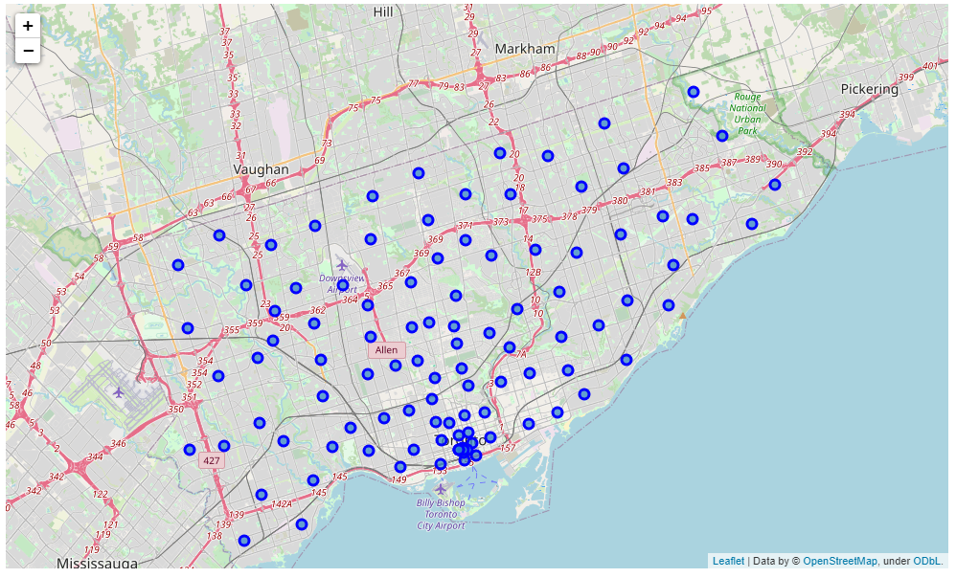
Map of scarborough

Slide 6
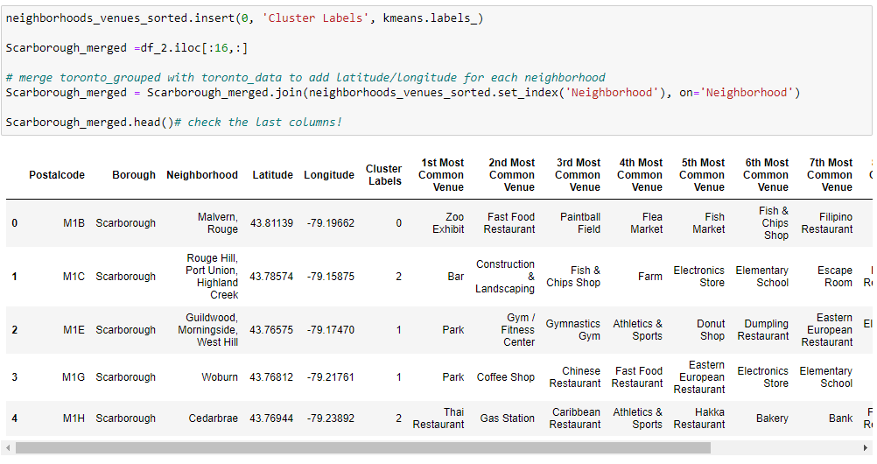
Methodology: Using k-means clustering approach

Slide 7
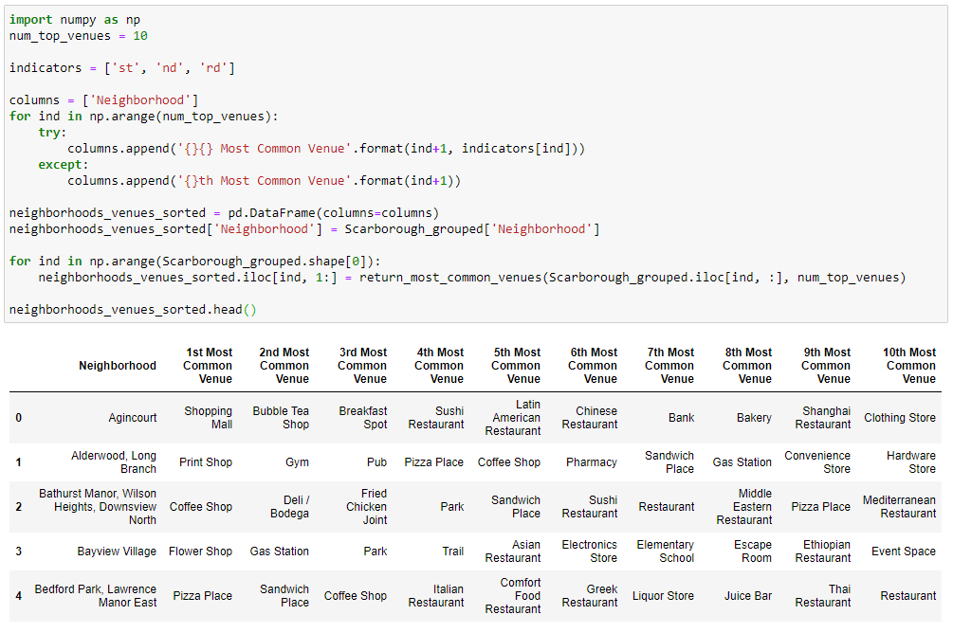
Most common venues near neighbourhood

Slide 8
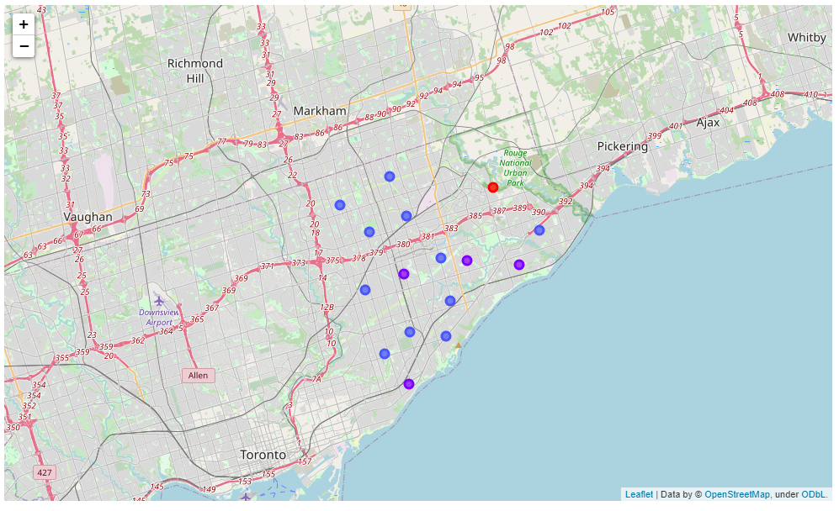
Results: Map of clusters in scarborough

Slide 9
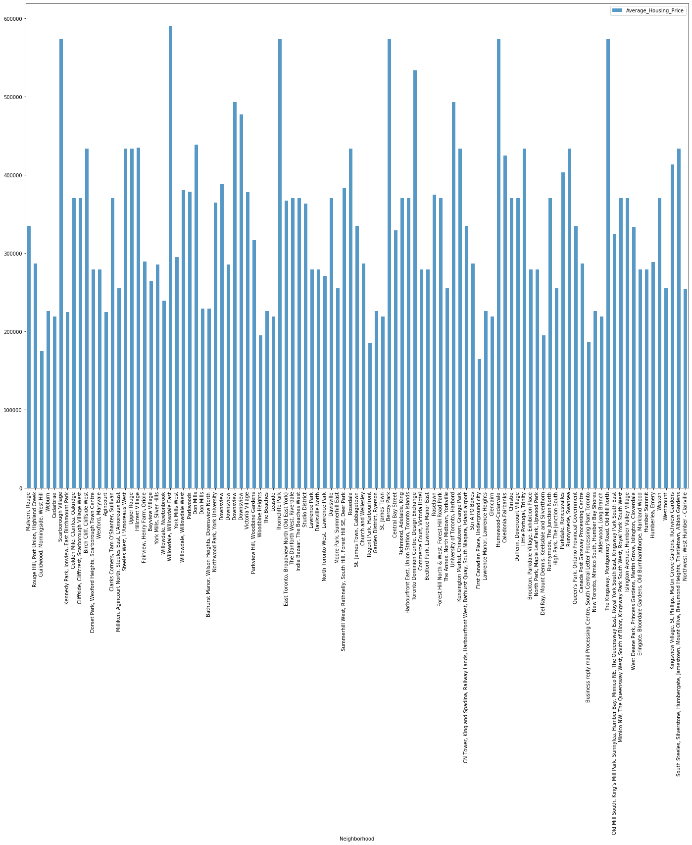
Average Housing Price by Clusters in Scarborough

Slide 10
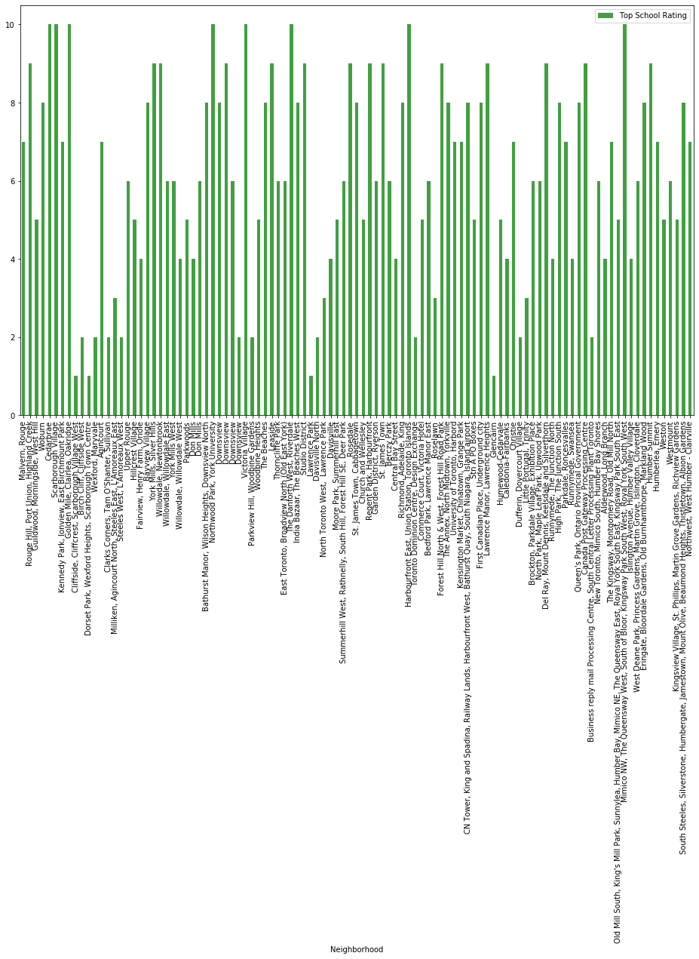
School Ratings by Clusters in Scarborough

Slide 11
Conclusion
In this project, using k-means cluster algorithm the neighborhood was separated into 10(Ten) different clusters and for 103 different latitude and longitude from dataset, which have very-similar neighborhoods around them. Using the charts above results are presented about Scarborough neighborhood based on average house prices and school.
This project has provided a practical application to resolve a potential real situation that has impact on personal and financial well being using Data Science tools. The mapping with Folium is a very powerful technique to consolidate information and make the analysis and decision better with greater confidence.

